Slide 1

Introduction to Data Analysis with R
Zaw Myo Tun
10-14 April 2023

Slide 2
Data visualisation

Slide 3
Learning objectives
The basics of ggplot2 package
How to create scatter plot, box plot, and bar plot
Faceting
How to customise plots (themes)
Arranging plots
Exporting plots

Slide 4
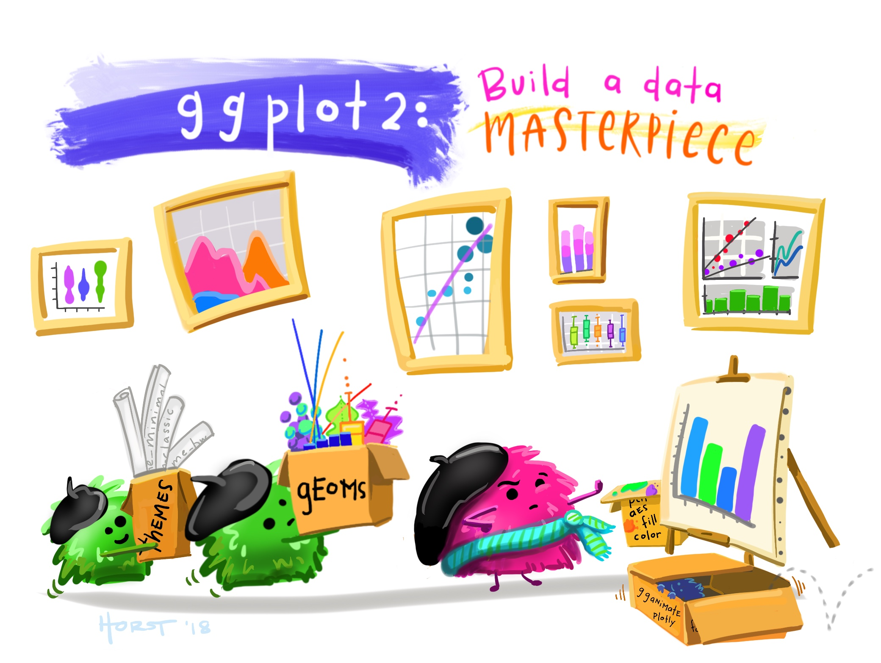

Slide 5
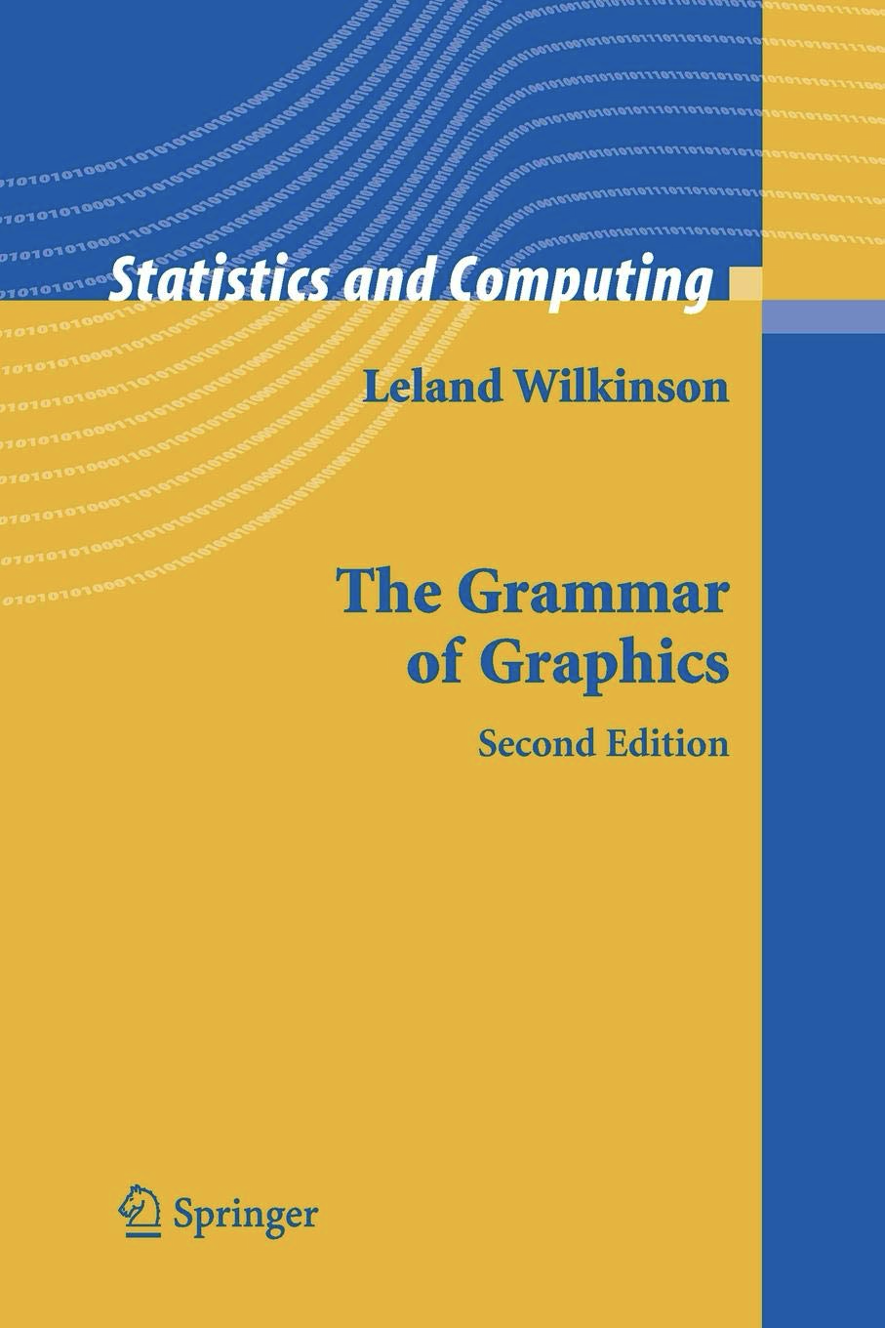
The Grammar of Graphics
1st edition in 1999
A theorical deconstruction of data graphics
Designing a unified system that allow the construction of any chart type we want and the way we want it to look
Foundation of many graphic applications
ggplot2
Polaris (-> Tableau)
Vega-Lite
https://github.com/thomasp85/ggplot2_workshop

Slide 6
The Idea
Scatter plot
Pie chart
Line chart
Bar chart
https://github.com/thomasp85/ggplot2_workshop

Slide 7
The Idea
Pie chart
Bar chart
Scatter plot
Line chart
GRAPHICS
https://github.com/thomasp85/ggplot2_workshop

Slide 8
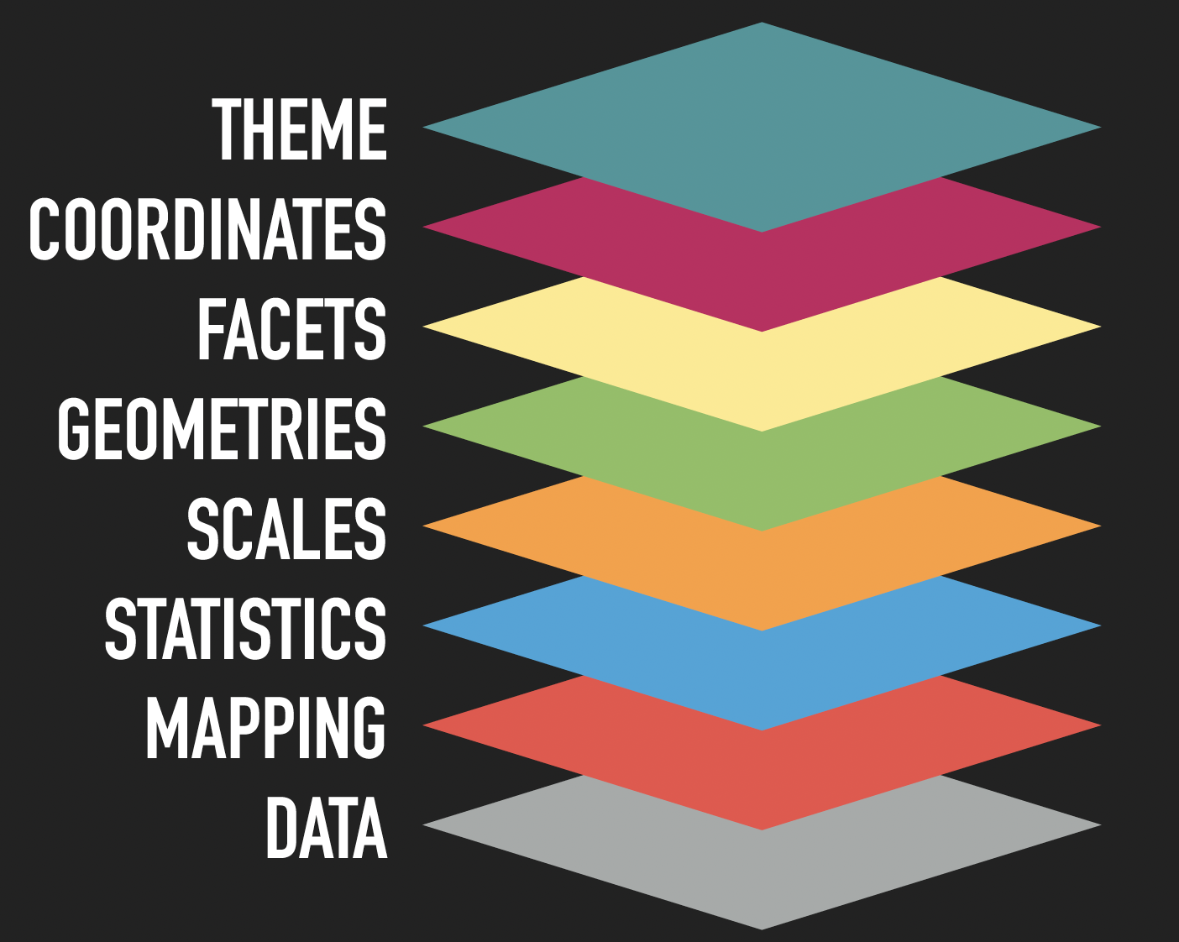
The Idea
Decompose graphics into its components
https://github.com/thomasp85/ggplot2_workshop

Slide 9
The Idea
Pie chart
Scatter plot
Bar chart
Line chart
https://github.com/thomasp85/ggplot2_workshop

Slide 10
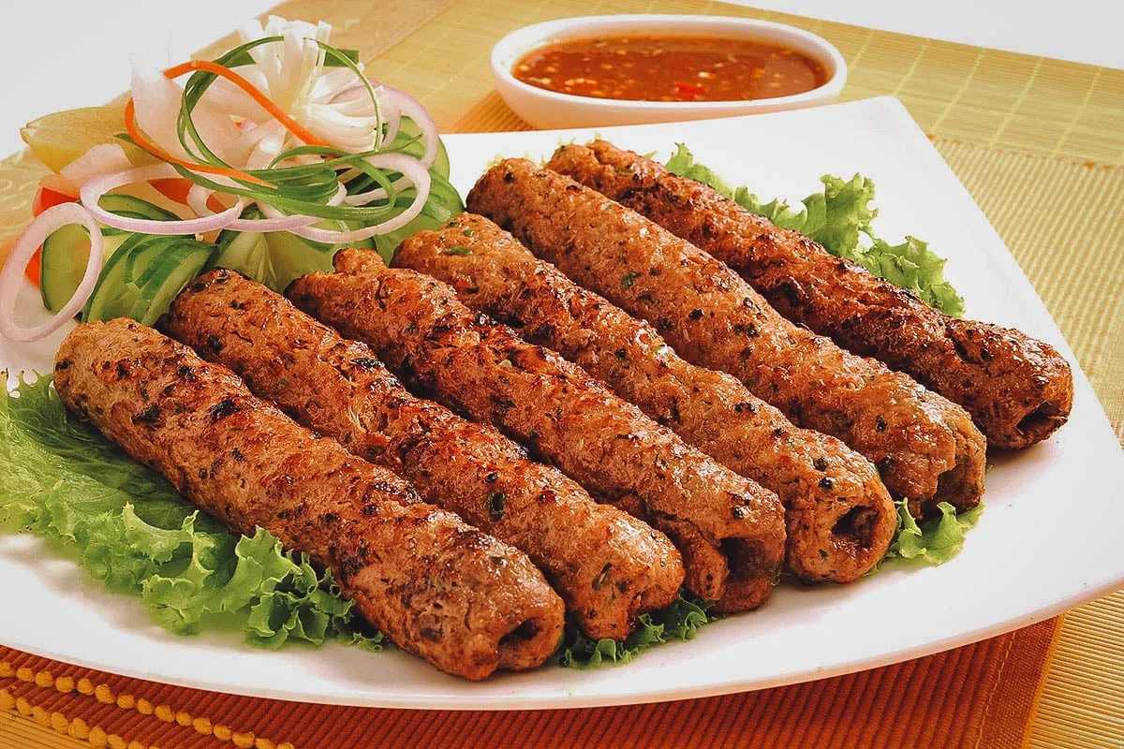
Seekh Kabab

Slide 11
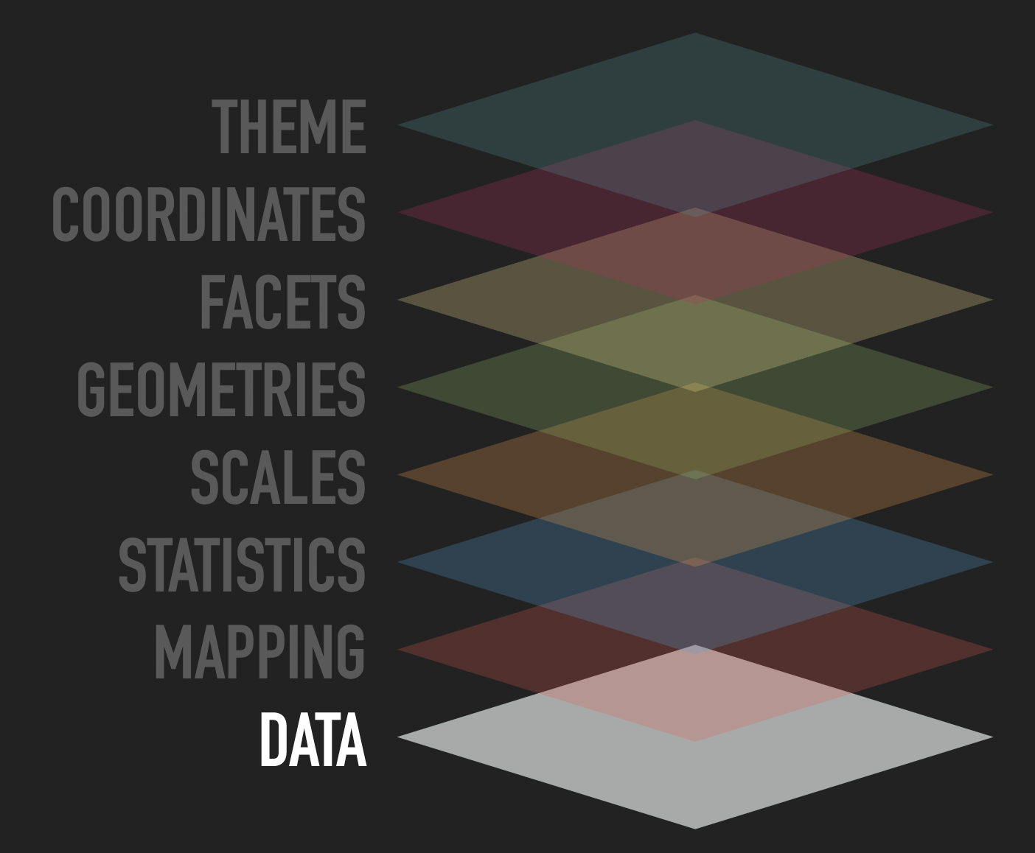
The Grammar
Representation defines what can be done with the data
Grammar requires tidy data format
https://github.com/thomasp85/ggplot2_workshop

Slide 12
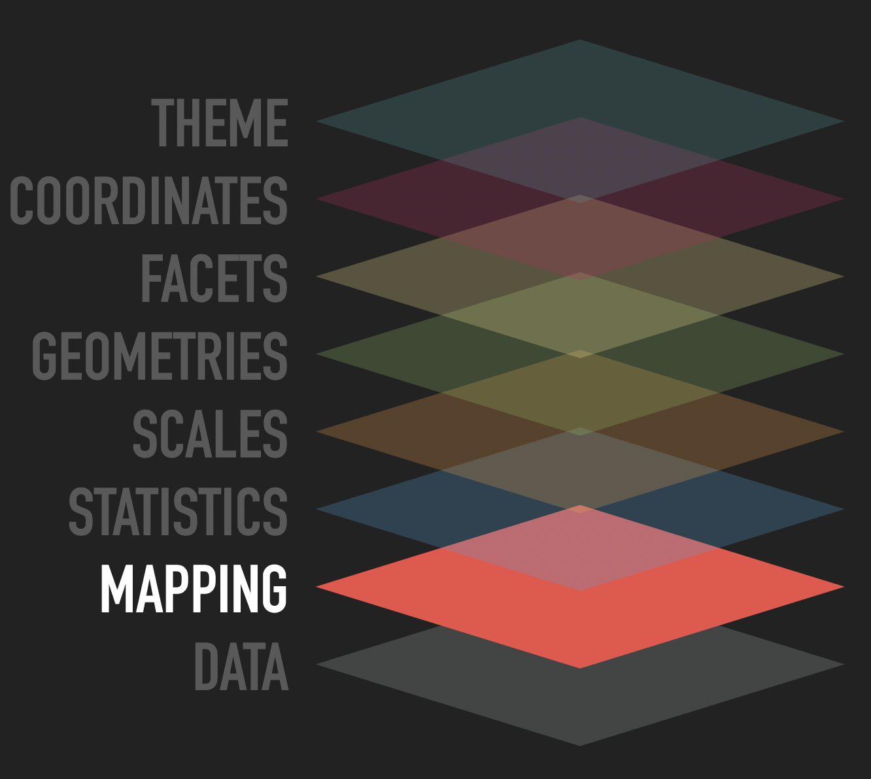
The Grammar
Allow generic datasets to be understood by the graphics system
Aesthetic mapping: Link variables in data to graphical properties in the geometry.
Facet mapping: Link variables in the data to panels in the facet layout.
https://github.com/thomasp85/ggplot2_workshop

Slide 13
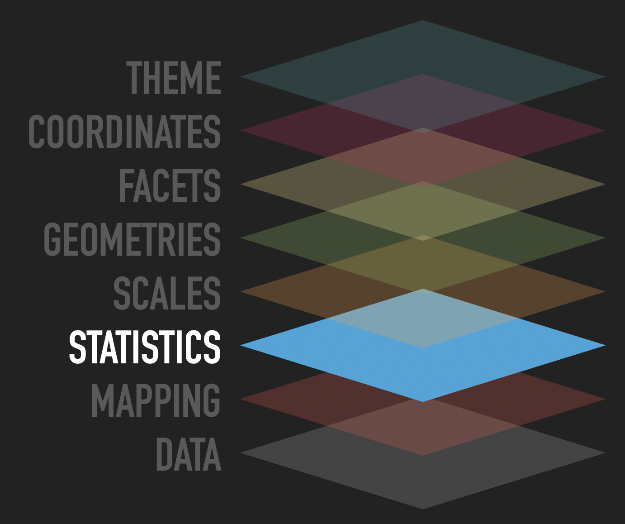
The Grammar
Even if the data is tidy, it may not represent the displayed value
Transform input variables to displayed values:
Count number of observations in each category for a bar chart
Calculate summary statistics for a boxplot.
Is implicit in many plot-types but can often be done prior to plotting
https://github.com/thomasp85/ggplot2_workshop

Slide 14
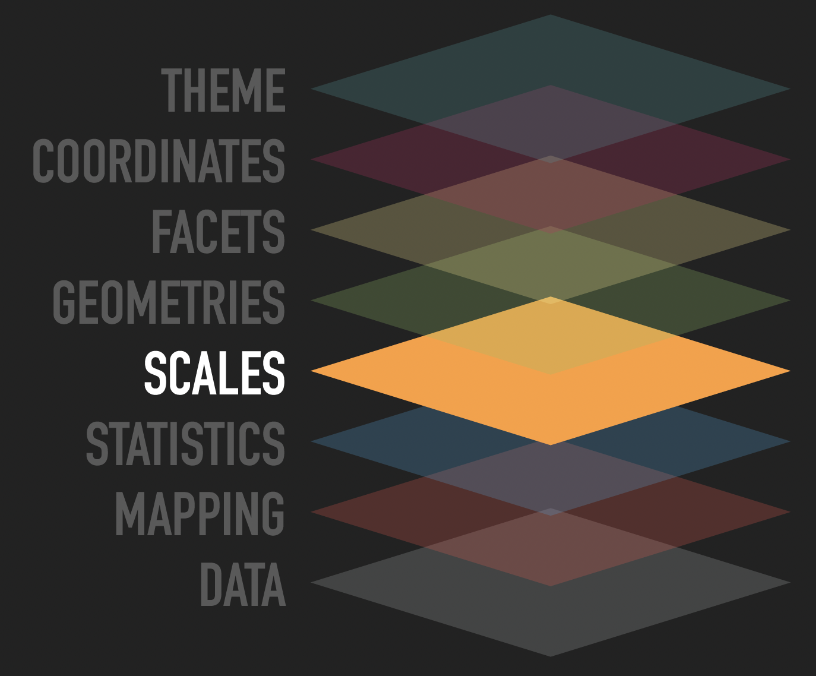
The Grammar
Most data does not directly represent graphical properties.
A scale translate back and forth between variable ranges and property ranges
Categories → Colour
Numbers → Position, size
…
Imply a specific interpretation of values; discrete, continuous, etc.
https://github.com/thomasp85/ggplot2_workshop

Slide 15
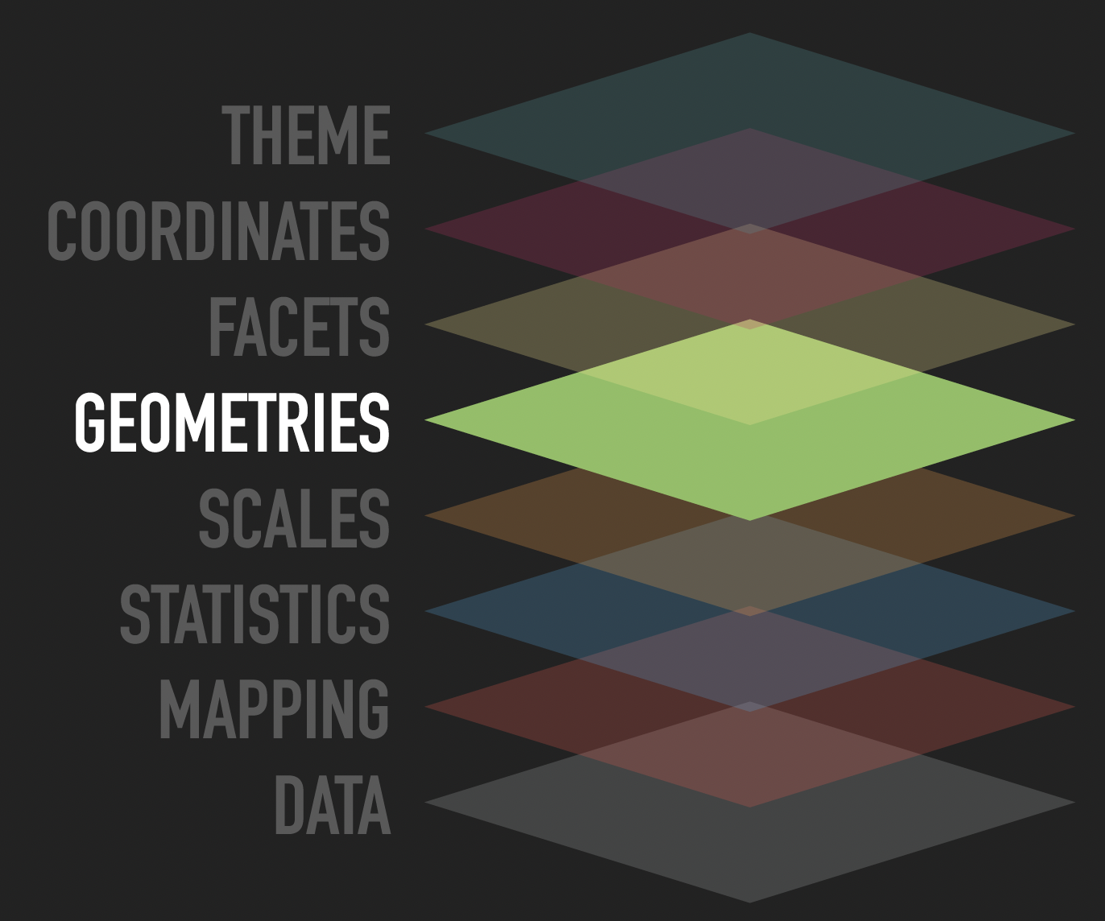
The Grammar
How to interpret aesthetics as graphical representations
Is a progression of positional aesthetics several points, a line, a single polygon, or something else entirely?
To a high degree the determinator of your plot type
https://github.com/thomasp85/ggplot2_workshop

Slide 16
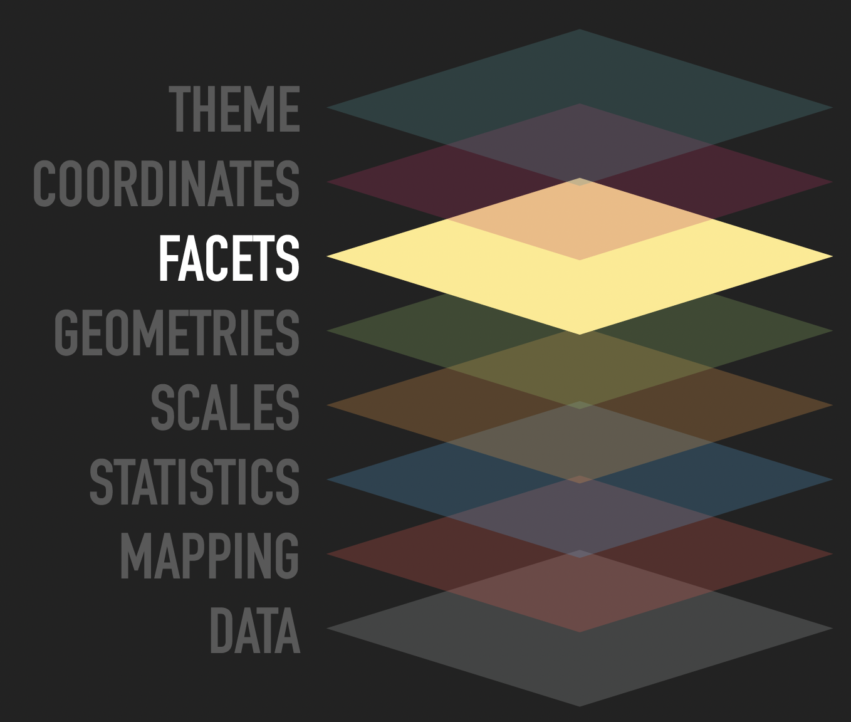
The Grammar
Define the number of panels with equal logic and split data among them…
Small multiples
Allows you to look at small subsets of your data in separate plots
https://github.com/thomasp85/ggplot2_workshop

Slide 17
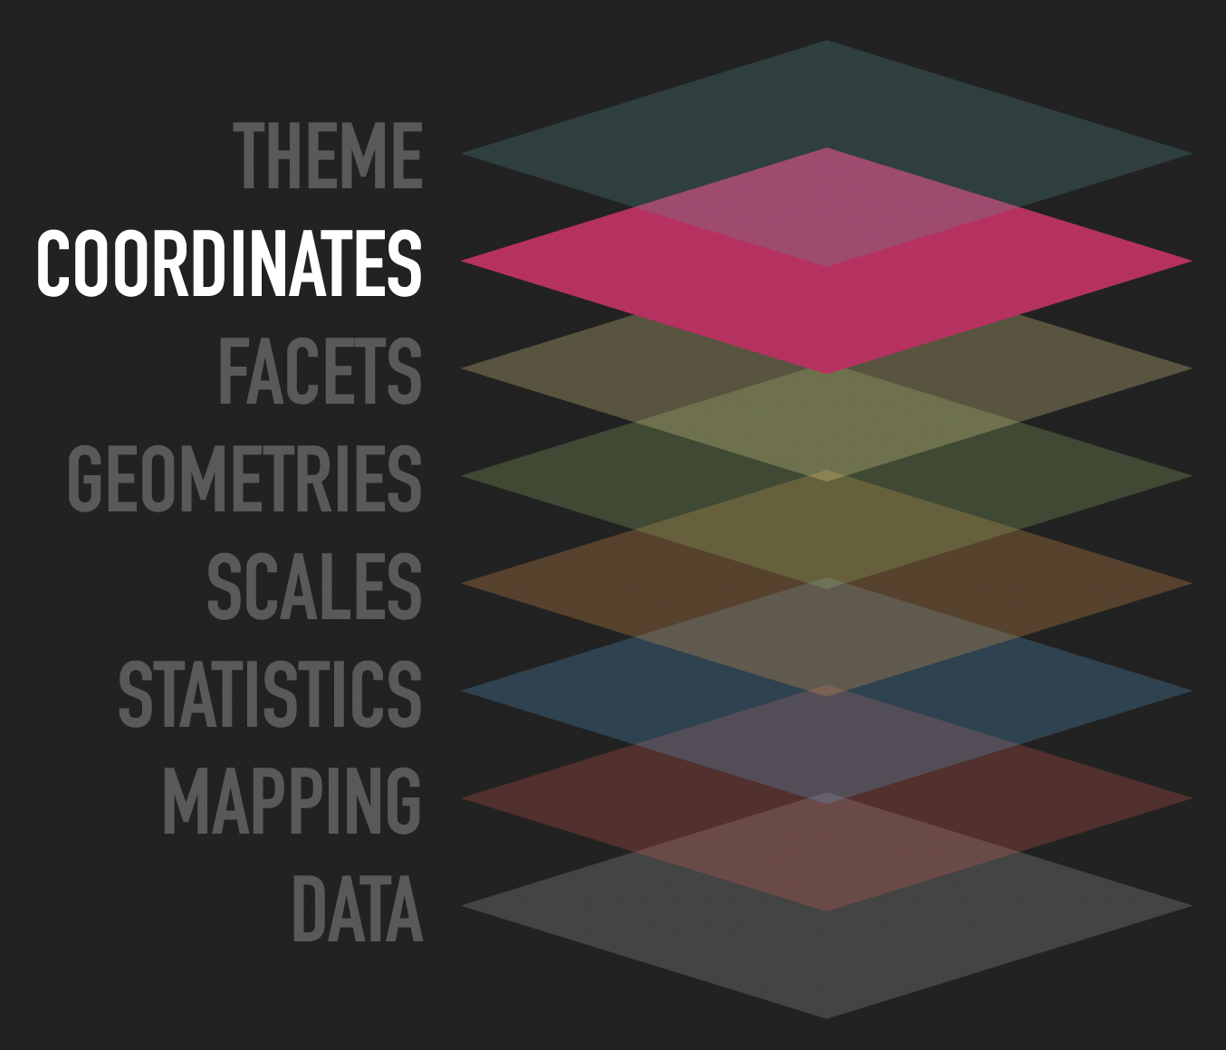
The Grammar
Positional aesthetics are special.
Variables are mapped, scaled, applied to a geometry
But in the end, the position values are interpreted by a coordinate system
Defines the physical mapping of the aesthetics to the paper
https://github.com/thomasp85/ggplot2_workshop
Notes:
Default cartesian system.

Slide 18
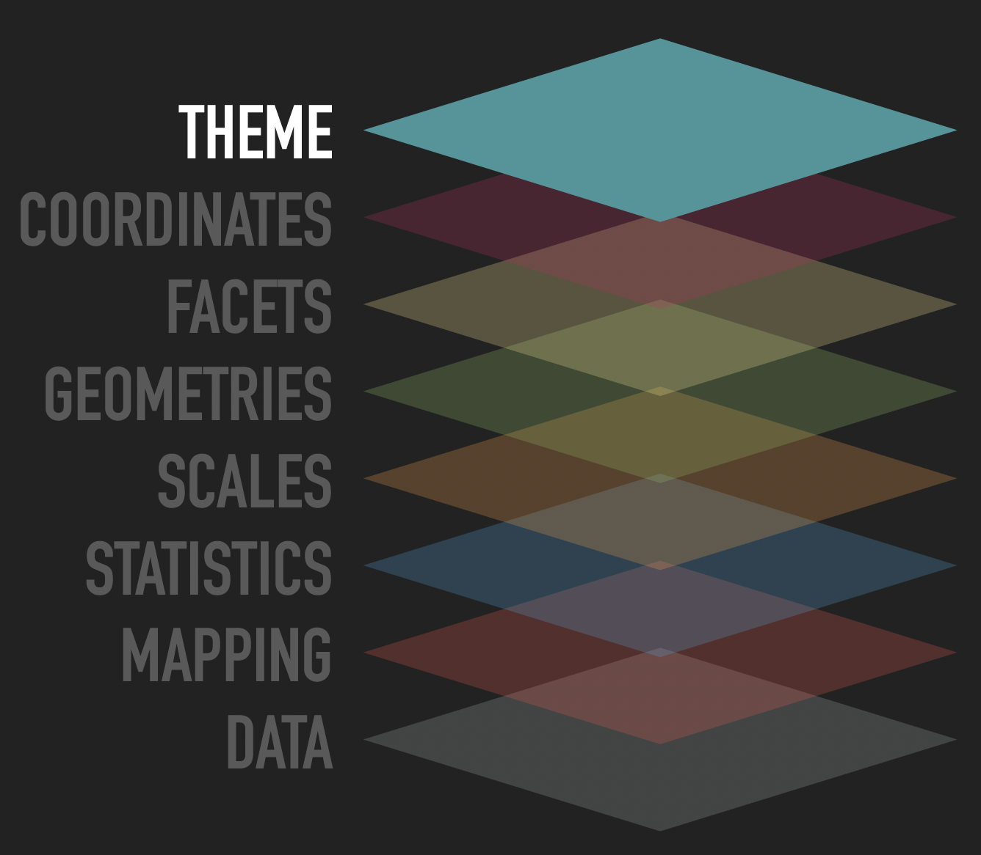
The Grammar
So far nothing has been said about the visual look of the plot.
Theming is about every part of the graphic that is not linked to the data.
https://github.com/thomasp85/ggplot2_workshop

Slide 19
But I just want to draw
a pie chart…..……

